Slide 1
For through Him God created everything in heaven and on earth. God created the whole universe through him and for him.
Colossians 1:16

Slide 2
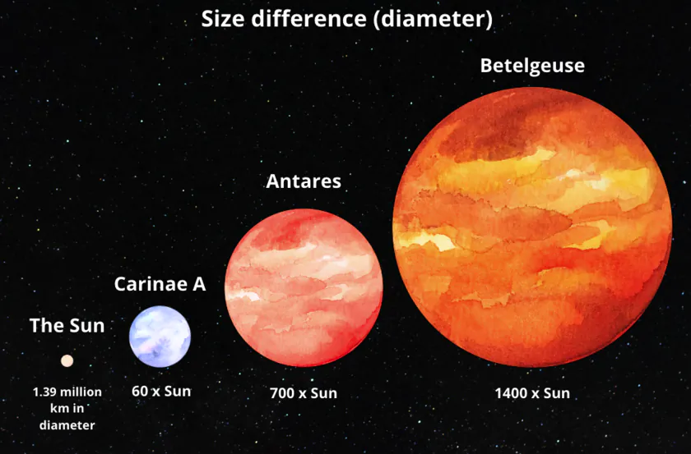

Slide 3
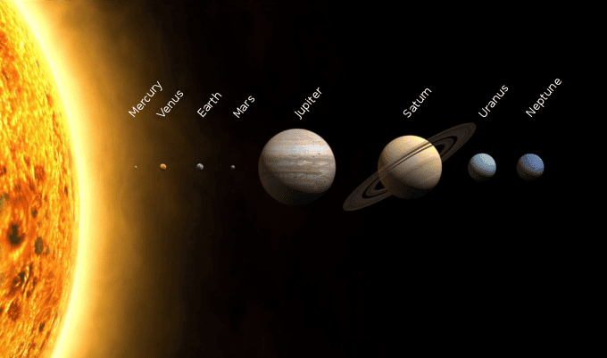

Slide 4
In the beginning God created
the Heavens and the earth
Genesis 1: 1

Slide 5
Before the world was created, the Word (Jesus) already existed; he was with God, and he was the same as God. … Through him God made all things; not one thing in all creation was made without him.
John 1:1,3

Slide 6
The Consequences of God being the Creator through Jesus
1. Jesus is Lord

Slide 7
The Consequences of God being the Creator through Jesus
I love the Lord because he hears me; he listens to my prayers. He listens to me every time I call to him. Psalm 116:1-2

Slide 8
The Consequences of God being the Creator through Jesus
Jesus is Lord
We have nothing to fear

Slide 9
The Consequences of God being the Creator through Jesus
Jesus is Lord
We have nothing to fear
For through Him (Jesus) God created everything in heaven and on earth, the seen and the unseen things, including spiritual powers lords, rulers, and authorities. Colossians 1:16

Slide 10
The Consequences of God being the Creator through Jesus
Jesus is Lord
We have nothing to fear
All authority in heaven and on earth has been given to me Matthew 28:18

Slide 11
The Consequences of God being the Creator through Jesus
Jesus is Lord
We have nothing to fear
You and I matter to God

Slide 12
The Consequences of God being the Creator through Jesus
Jesus is Lord
We have nothing to fear
You and I matter to God
“ from Goo to You by way of the Zoo”.
Chuck Missler

Slide 13
The Consequences of God being the Creator through Jesus
Jesus is Lord
We have nothing to fear
You and I matter to God
Jesus is the key

Slide 14
The Consequences of God being the Creator through Jesus
Jesus is Lord
We have nothing to fear
You and I matter to God
Jesus is the key
in union with him all things have their proper place Colossians 1:17

Slide 15
The Consequences of God being the Creator through Jesus
Jesus is Lord
We have nothing to fear
You and I matter to God
Jesus is the key
He guides me in paths of righteousness Psalm 23:3

Slide 16
The Consequences of God being the Creator through Jesus
Jesus existed before the world began
Through him all creation came into being
Jesus is not only the reason for the season – he is the reason for everything
Life makes sense, and can be lived to the full, only when you and I are in relationship with Jesus Christ. Trust him

